Slide 1
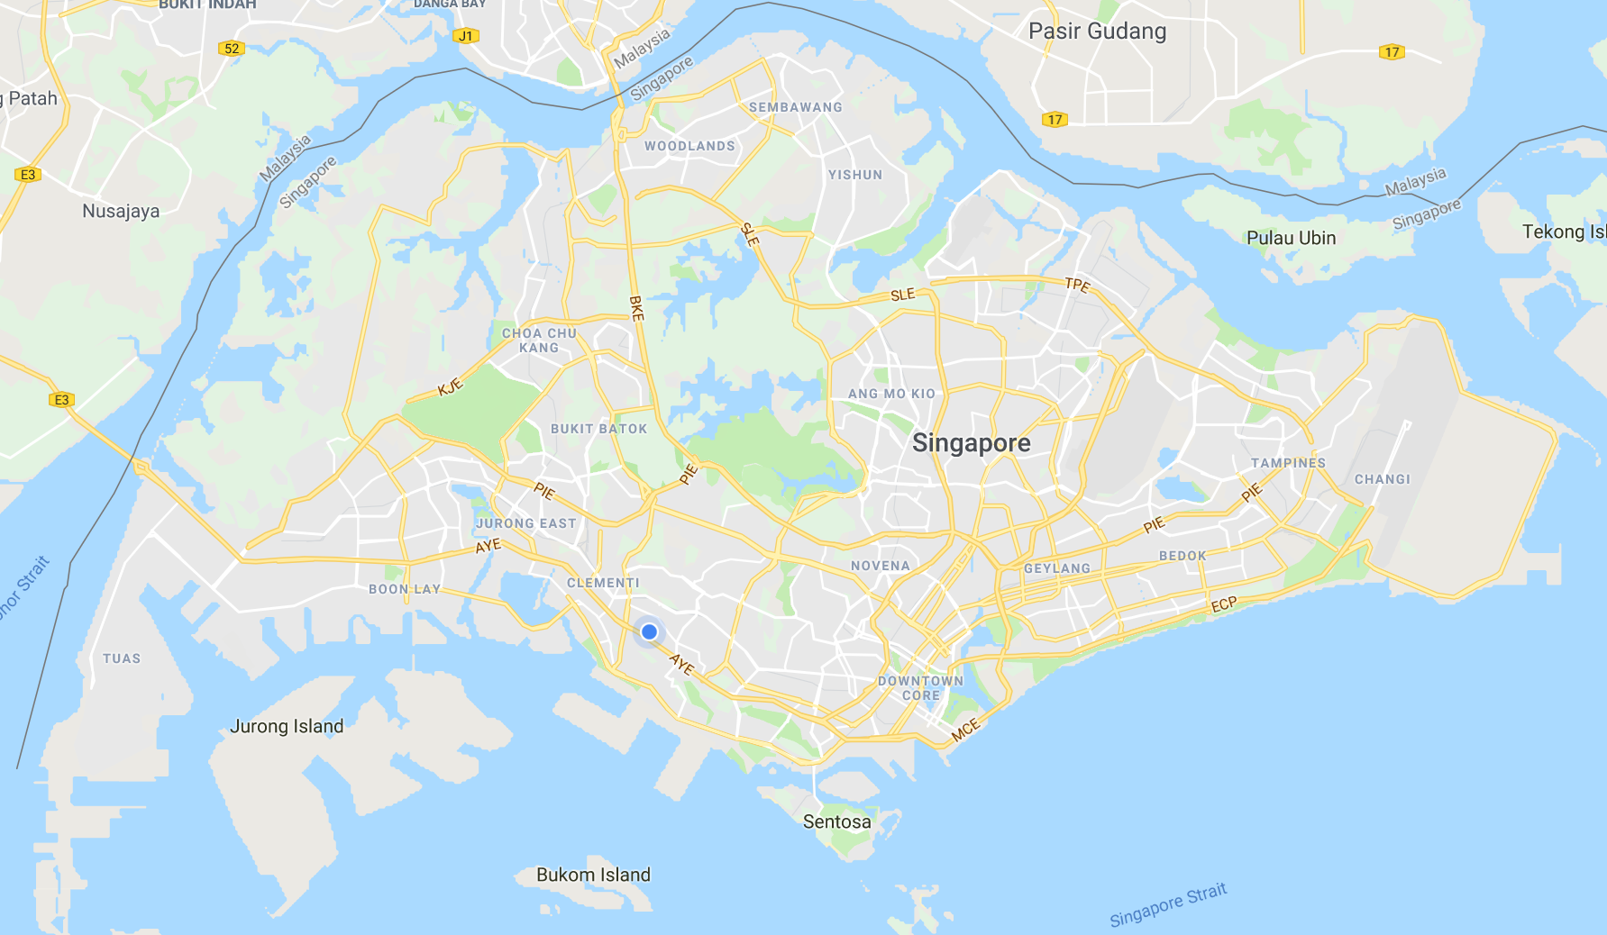
quickER
Please select your location
Search

Slide 2

Back quickER
NUH:
Travel: 9
Wait: 14
KKH:
Travel: 20
Wait: 48
3
1
2
SGH:
Travel: 15
Wait: 32
1. National University Hospital
23
minutes
2. Singapore General Hospital
47
minutes
3. KK Women’s and Children’s Hospital
68
minutes

